Slide 1
PROJECT’S EVALUATION

Slide 2
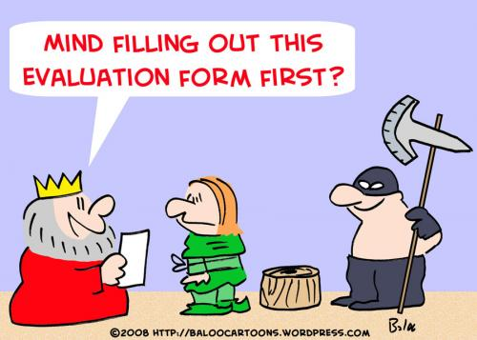
END OF YEAR EVALUATION

Slide 3
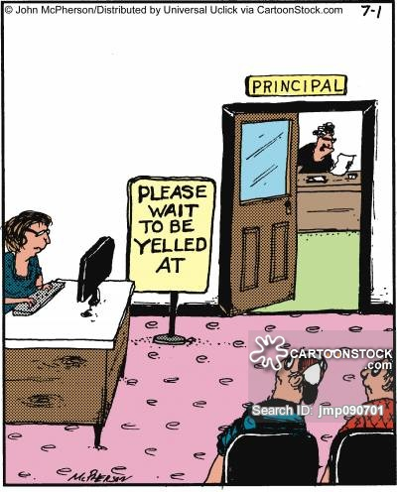
1. Lesson observation form (Conducted by the Head teacher)

Slide 4
1. Which of the following teaching methods have been used during this lesson?
Project-based learning and peer-learning have been used by the majority of the teachers. Webquest has been the heart of the particular lesson for fewer teachers, as they found it rather time consuming & much elaborated. Learning by teaching, although not complicated at all, it’s been used by even fewer teachers (3) (maybe because such a method may act as a “stirrer.

Slide 5
2. Has ICT been used during this lesson?
ICT has been used by the majority of the teachers (20/22). Indeed, they are convinced about the pedagogical benefits of a computer mediated course. Of course they are facilitated by the fact that all classrooms are equipped with a computer, beamer, overhead projector & internet access.

Slide 6
3. The teacher has encouraged the pupils to work collaboratively.
The majority of teachers (18/22) seem to have encouraged pair & group work. What’s more, they have made sure each member within the group has been able to resume a role.

Slide 7
4. The children were interested in the lesson activities.
The activities set by the teachers appeared pretty appealing for the pupils. There was noticed quite active participation of the majority of the learners.
Still, there was a small number (3) that did not seem to regard the tasks interesting enough.

Slide 8
5. The children maintained motivation throughout the lesson.
The results here pinpoint how highly engaged the learners have been during the lesson. Pupils seem really motivated and eager to interact with each other.

Slide 9
B. Parents-24
Impact Evaluation Form

Slide 10
1.I think that after participating in the project my child is more interested in learning in general.
This graph depicts that parents’ view is evenly divided between “A little” & “Yes”.
Hence, half regard their child’s involvement with the project has been really helpful and encouraged them towards learning. Yet, the same number believes it’s made a little difference.

Slide 11
2. I think that after participating in the project my child's motivation to learn foreign languages has increased.
As for motivation, 16/24 consider that their child’s engagement with the particular project has helped increase their motivation towards learning F.L., 6 think it helped a little, whereas 2 responded negatively.

Slide 12
3. I think that my child's self-confidence and self-esteem has been increased as a result of participating in this project.
Project participation seems to have also enhanced their kids’ self-esteem (14/24). They agreed that the alternative teaching/learning methods helped them experiment with the language and take risks.

Slide 13
4. I think that this project was an important part of this year school educational offer.
18/24 parents believe that the particular project has been an essential educational offer. They realized that going further & beyond the curriculum and bringing about such syllabus novelties their children are strong candidates for becoming autonomous learners.

Slide 14
5. I think that the methods of working with students applied in the project should be used more often.
Quite many (20/24) affirm that the variety of teaching/learning methods applied throughout the project have been really appealing and challenging and thus should be used more frequently.

Slide 15
6. I would like my child to work again on a similar cooperation project.
Here we detect a unanimous positive response. It seems they have realized that such cooperations allow their children to meet learning challenges which ameliorate the teaching/learning context.

Slide 16
C. PUPILS-22
IMPACT
EVALUATION FORM

Slide 17
1. I think that what I learn depends mostly on my own decisions.
Pupils (15/22) have been so actively involved in the effective implementation of the tasks at hand that they’ve come up with the feeling that they really have learned by choice.

Slide 18
2. I can find and organize information which I need for different tasks.
The majority of the pupils (19/22) admit the fact that they are now more able to search and locate information they need in order to carry out a task.

Slide 19
3. I feel confident about cooperating with my classmates and working in a team on different tasks.
Although pupils were already familiar with group work, the project has assisted them in furthering their collaborative skills. They said they now feel more confident when they have to cooperate with classmates, working in groups or in pairs.

Slide 20
4. I can see where there is room for improvement in my knowledge.
12/22 pupils were enabled to self-assess themselves, evaluate their progress and trace the areas in need of improvement.

Slide 21
5. I see the need for improving my foreign language skills.
A great number of pupils argued for the need for improving their E.F. L. skills and especially their productive skills & subskills.

Slide 22
6. I think it is important to keep learning new things, even in adult life.
16/22 students agree on the importance of keeping learning new things. Carrying out those tasks with alternative teaching/ learning methods has raised their level of motivation with regards to long-life learning.

Slide 23
7. I am going to stay in touch with some children from other countries.
Quite many pupils expressed their desire to keep in touch with their partners. Especially those who have already been given hospitality.

Slide 24
8. I would like to work again on a cooperation project.
The majority of pupils are keen on being involved in such a project again. Every time we had to perform an Erasmus task they were so excited that they even negotiated with their mainstream teacher the extension of the time allotted for the completion of the task.

Slide 25
ANY QUESTIONS? NO? GREAT!!!

