Slide 1
PROJECT’S EVALUATION

Slide 2
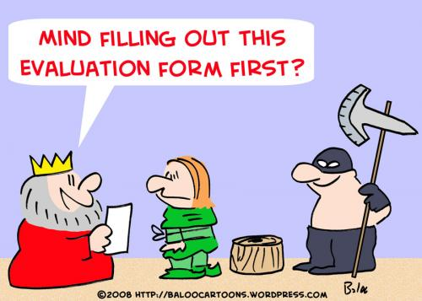
END OF YEAR EVALUATION

Slide 3
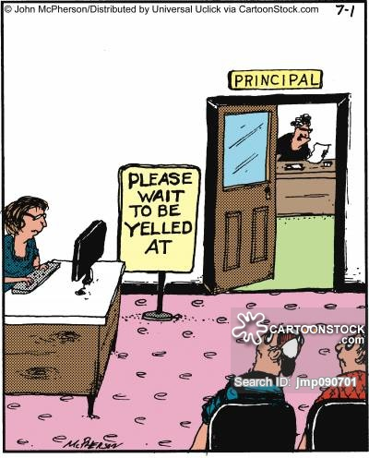
1. Lesson observation form (Head teacher)

Slide 4
Comment
Although the form refers to one lesson only, the head teacher actually attended each class more than once, because the school advisor asked our teachers to make a number of presentations to teachers of other schools.

Slide 5
1. Which of the following teaching methods have been used during this lesson?
Project-based learning and peer-learning were used by the majority of the teachers. Webquest was the heart of the particular lesson for only one teacher (as they found it rather time consuming & much elaborated). Learning by teaching was used by (4) teachers (maybe because such a method may act as a “stirrer.

Slide 6
2. Has ICT been used during this lesson?
ICT was used by all the teachers. Indeed, they are convinced about the pedagogical benefits of a computer mediated course. Of course they are facilitated by the fact that all classrooms are equipped with a computer, beamer, overhead projector & internet access.

Slide 7
3. The teacher has encouraged the pupils to work collaboratively.
The majority of teachers seem to have encouraged pair & group work. What’s more, they have made sure each member within the group has been able to resume a role.

Slide 8
4. The children were interested in the lesson activities.
The activities set by the teachers appeared pretty appealing for the majority of the pupils.

Slide 9
5. The children maintained motivation throughout the lesson.
The results here pinpoint how highly engaged the learners have been during the lesson. Pupils seem really motivated and eager to interact with each other.

Slide 10
B. Parents-25
Impact Evaluation Form

Slide 11
1.I think that after participating in the project my child is more interested in learning in general.
This graph depicts that the majority (17/25) regard their child’s involvement with the project has been really helpful and encouraged them towards learning. Yet, 8 parents believe it’s made a little difference.

Slide 12
2. I think that after participating in the project my child's motivation to learn foreign languages has increased.
As for motivation, the majority again , i.e., ‘Mostly’ ( 8) & ‘Yes’ (9), consider that their child’s engagement with the particular project has helped increase their motivation towards learning F.L.
There is also a quite large number of parents 8 that believe it helped them “A Little”.

Slide 13
3. I think that my child's self-confidence and self-esteem has been increased as a result of participating in this project.
Project participation seems to have also enhanced their kids’ self-esteem (19/25). They agreed that the alternative teaching/learning methods helped them experiment with the language and take risks. Yet, there were 2 parents who responded negatively, and 4 that believd it helped their kids “A little”

Slide 14
4. I think that this project was an important part of this year school educational offer.
An almost unanimous) answer. 24/25
parents believe that the particular project has been an essential educational offer. They’ve realized that going further & beyond the curriculum and bringing about such syllabus novelties their children are strong candidates for becoming autonomous learners.

Slide 15
5. I think that the methods of working with students applied in the project should be used more often.
Quite many (21/27) affirm that the variety of teaching/learning methods applied throughout the project have been really appealing and challenging and thus should be used more frequently. 4 parents did not totally agree.

Slide 16
6. I would like my child to work again on a similar cooperation project.
Here we detect a unanimous positive response (7 Mostly & 18 Yes). It seems they have realized that such cooperations allow their children to meet learning challenges which ameliorate the teaching/learning context.

Slide 17
C. PUPILS-23
IMPACT
EVALUATION FORM

Slide 18
1. I think that what I learn depends mostly on my own decisions.
20/23 pupils (14 mostly/6 Yes), have been so actively involved in the effective implementation of the tasks at hand that they’ve come up with the feeling that they really have learned by choice.

Slide 19
2. I can find and organize information which I need for different tasks.
The majority of the pupils (22/23) admit the fact that they are now more able to search and locate information they need in order to carry out a task.

Slide 20
3. I feel confident about cooperating with my classmates and working in a team on different tasks.
Although pupils were already familiar with group work, the project has assisted them in furthering their collaborative skills. They said they now feel more confident when they have to cooperate with classmates, working in groups or in pairs.

Slide 21
4. I can see where there is room for improvement in my knowledge.
Almost everybody (4 mostly, 19 Yes), were enabled to self-assess themselves, evaluate their progress and trace the areas in need of improvement.

Slide 22
5. I see the need for improving my foreign language skills.
Again all the pupils (2 mostly, 21 Yes), argued for the need for improving their E.F. L. skills and especially their productive skills & subskills.

Slide 23
6. I think it is important to keep learning new things, even in adult life.
22/23 ( 6 mostly, 16 Yes) students agree on the importance of keeping learning new things. Carrying out those tasks with alternative teaching/ learning methods has raised their level of motivation with regards to long-life learning.

Slide 24
7. I am going to stay in touch with some children from other countries.
15/23 pupils expressed their desire to keep in touch with their partners. Especially those who have already been given or gave hospitality.

Slide 25
8. I would like to work again on a cooperation project.
The majority of pupils : 22 (3 Mostly/ 19 Yes) would love to be involved in a similar cooperative project again.
Indeed every time we had to perform an Erasmus task, they said, “ Great, no English today! Erasmus! Hooray!”

