Slide 1
PROJECT’S EVALUATION

Slide 2
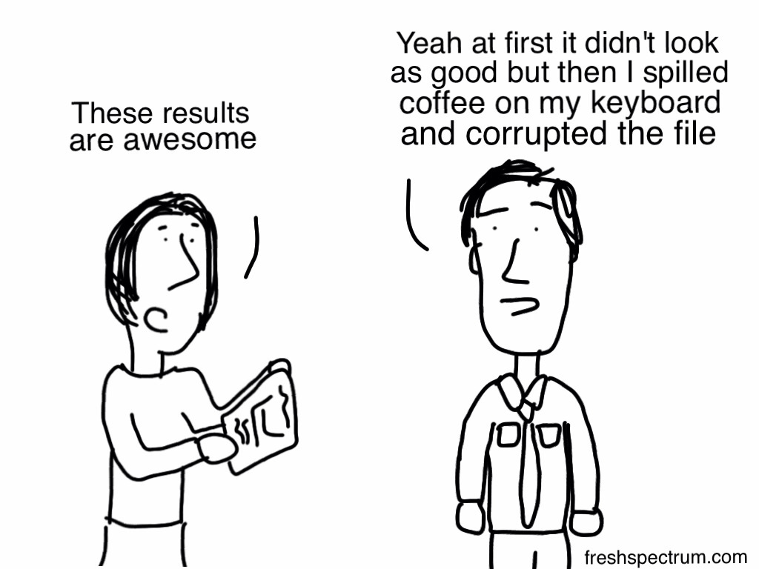
END OF YEAR EVALUATION

Slide 3
Parents-24
Impact Evaluation Form

Slide 4
1.I think that after participating in the project my child is more interested in learning in general.
This graph depicts that parents’ view is almost evenly divided between “Mostly 14” & “Yes 10”.
Hence, they regard their child’s involvement with the project has been really helpful and encouraged them towards learning.

Slide 5
2. I think that after participating in the project my child's motivation to learn foreign languages has increased.
As for motivation, 16/24 consider that their child’s engagement with the particular project has helped increase their motivation towards learning F.L., 6 think it helped a little, whereas 2 responded negatively.

Slide 6
3. I think that my child's self-confidence and self-esteem has been increased as a result of participating in this project.
Project participation seems to have also enhanced their kids’ self-esteem (16/24=yes, 4=mostly). They agreed that the alternative teaching/learning methods helped them experiment with the language and take risks.

Slide 7
4. I think that this project was an important part of this year school educational offer.
18/24 parents believe that the particular project has been an essential educational offer. They realized that going further & beyond the curriculum and bringing about such syllabus novelties their children are strong candidates for becoming autonomous learners.

Slide 8
5. I think that the methods of working with students applied in the project should be used more often.
Quite many (20/24) affirm that the variety of teaching/learning methods applied throughout the project have been really appealing and challenging and thus should be used more frequently.

Slide 9
6. I would like my child to work again on a similar cooperation project.
Here we detect a unanimous positive response. It seems they have realized that such kinds of cooperation allow their children to meet learning challenges which ameliorate the teaching/learning context.

Slide 10
PUPILS-24
IMPACT
EVALUATION FORM

Slide 11
1. I think that what I learn depends mostly on my own decisions.
Pupils (15/24=yes, 7=mostly) have been so actively involved in the effective implementation of the tasks at hand that they’ve come up with the feeling that they have really learned by choice.

Slide 12
2. I can find and organize information which I need for different tasks.
The majority of the pupils (20/24=yes, 4/24=mostly) admit the fact that they are now more able to search and locate information they need in order to carry out a task.

Slide 13
3. I feel confident about cooperating with my classmates and working in a team on different tasks.
Although pupils were already familiar with group work, the project has assisted them in furthering their collaborative skills. They said (12/24=yes, 10/24=mostly) they now feel more confident when they have to cooperate with classmates, working in groups or in pairs.

Slide 14
4. I can see where there is room for improvement in my knowledge.
Again the majority (12/24= yes, 8/24=mostly) of pupils were enabled to self-assess themselves, evaluate their progress and trace the areas in need of improvement.

Slide 15
5. I see the need for improving my foreign language skills.
A great number of pupils (15/24=yes, 4/24=mostly), argued for the need for improving their E.F. L. skills and especially their productive skills & subskills.

Slide 16
6. I think it is important to keep learning new things, even in adult life.
18/24 students agree on the importance of keeping learning new things. Carrying out those tasks with alternative teaching/ learning methods has raised their level of motivation with regards to long-life learning.

Slide 17
7. I am going to stay in touch with some children from other countries.
Quite many pupils (19/24=yes, 3/24=mostly) expressed their desire to keep in touch with their partners. Especially those who have already been given hospitality.

Slide 18
8. I would like to work again on a cooperation project.
The majority of pupils (20/24) are keen on being involved in such a project again. Every time we had to perform an Erasmus task they were so excited that they even negotiated with their mainstream teacher the extension of the time allotted for the completion of the task.

