Slide 1
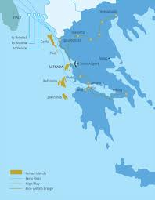
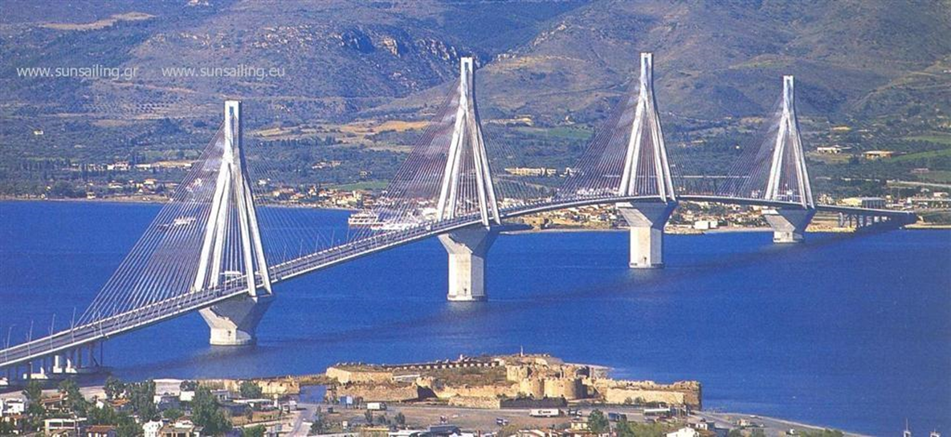
RIO – ANTIRRIO BRIDGE
There have been more than 100 years since the prime minister of Greece at that time, Charilaos Trikoupis, envisioned the connection of two cities Rio – Antirrio

Slide 2
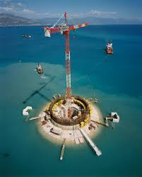
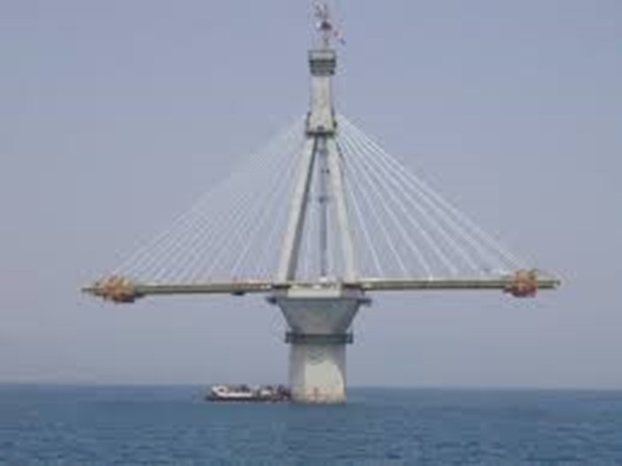
History
That vision became reality with the beginning of the construction of the bridge in 1998. In charge of the study and of the construction was the French company Vinci in cooperation with the biggest Greek construction companies (Actor , J&P and Athens)

Slide 3
History
It rises 52 meters above sea level (65m) and is located right above a seismically active gap .
It was very difficult to build, because the terrain is very soft and the bridge will be destroyed if a big earthquake happens (over 9 Richter).
That’s why they used lots of huge pylons, burried in the sand, in order to build a stable and safe bridge.

Slide 4
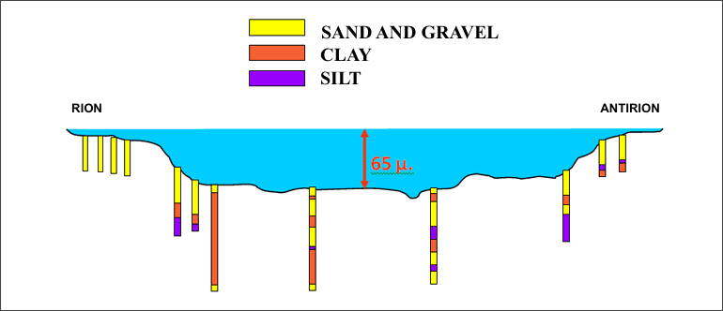
Construction

Slide 5
Construction
The length of the bridge, which is based on 4 pillars, is 2.252 meters .
The bridge’s width is 28 m.
It has has four pylons.
It has two vehicle lanes per direction, an emergency lane and a pedestrian walkway.

Slide 6
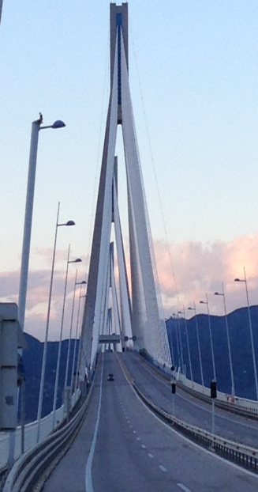
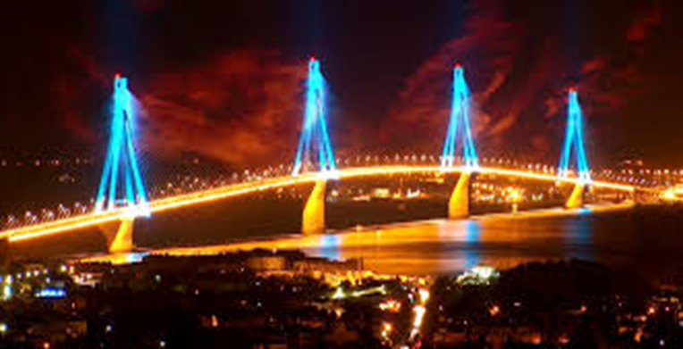
Rio – Antirrio Bridge
The construction of the bridge cost
630.000.000 euros.
It is the second biggest cable-stayed
bridge in the world (2883 meters
long)!

Slide 7
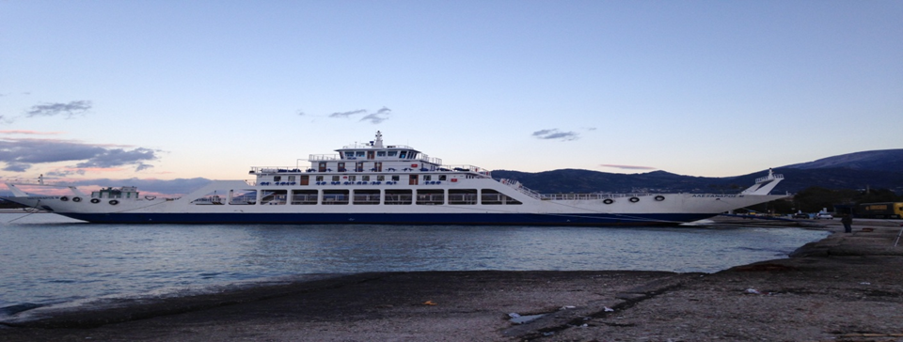
Rio – Antirrio Bridge
In 1995, 7.000 cars travelled every day between the two cities. The transportation was made by small ships called ferry – boats.
Today more than 10.000 cars pass the bridge daily, making the travel fast and easy.

Slide 8
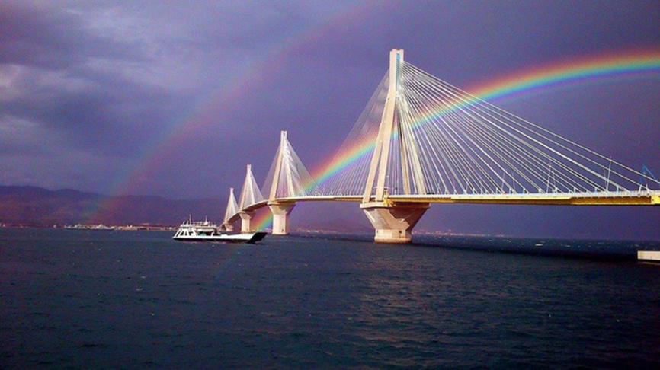
Rio – Antirrio Bridge
The connection of Rio-Antirrio with “Charilaos Trikoupis” Bridge helps the travellers:
cross the bridge in only 5 minutes, whereas travelling by the ferry boat it took them around 45 min.
drive on a wide and safe road.
reach their destination despite the bad weather conditions.

Slide 9
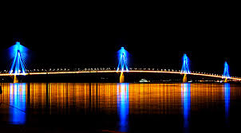
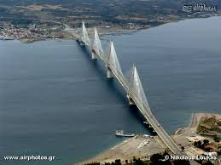
The Bridge today
The bridge at night!
The bridge from above!

Slide 10
Rio – Antirrio Bridge
Thanks for watching!!!!!!!!!!!!!!!!!!!!
Angelina Loi, Billy Maroudas, Maria Politi

