Slide 1
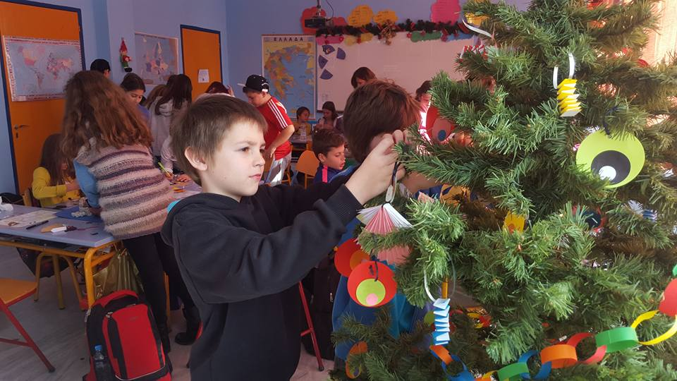
PERFORMING THE TASKS
PERFORMING THE TASKS
Polish pupils decorating the Xmas tree on the guest day

Slide 2
Module 1-Geography: Drawing/ matching

Slide 4
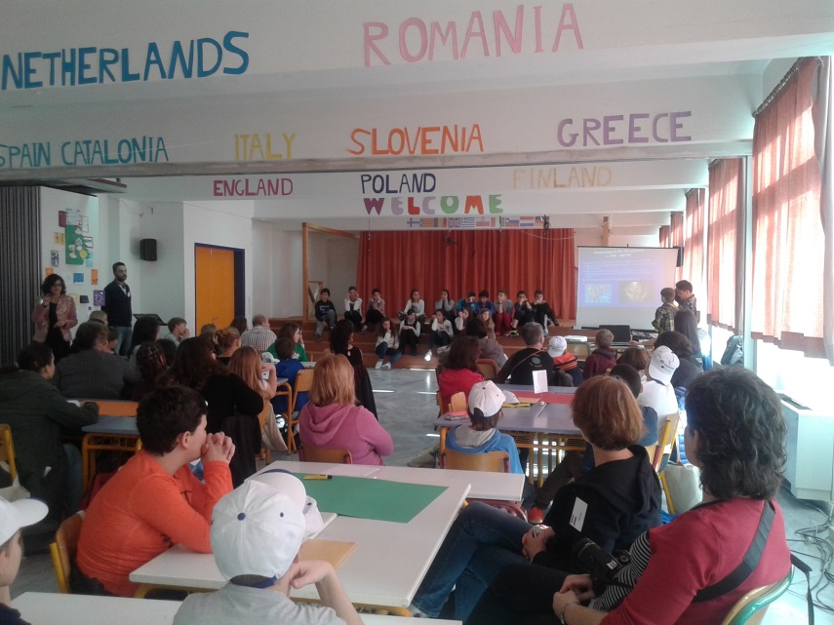
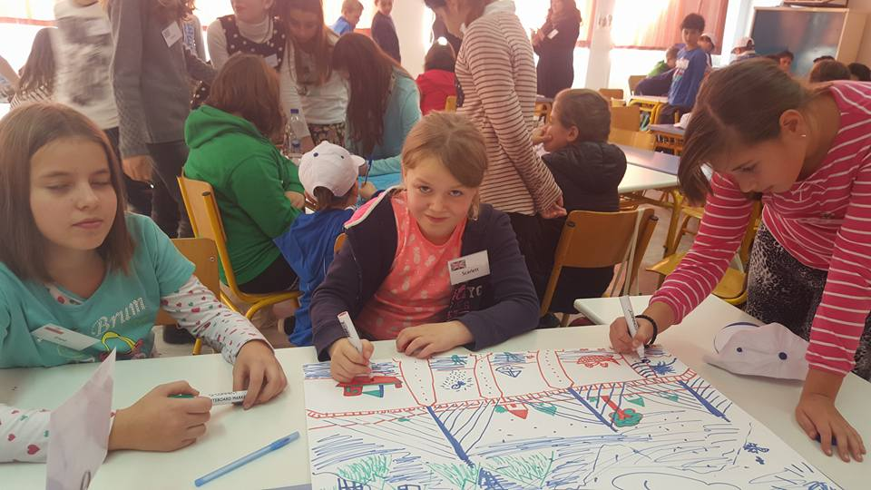
MODULE 2-INFRASTRUCTURE: The Rio-Antirio bridge

Slide 5
Module 2-History

Slide 6
Matching activity

Slide 7
Module 3: Byzantine Art

Slide 8
Creating mosaics

Slide 9
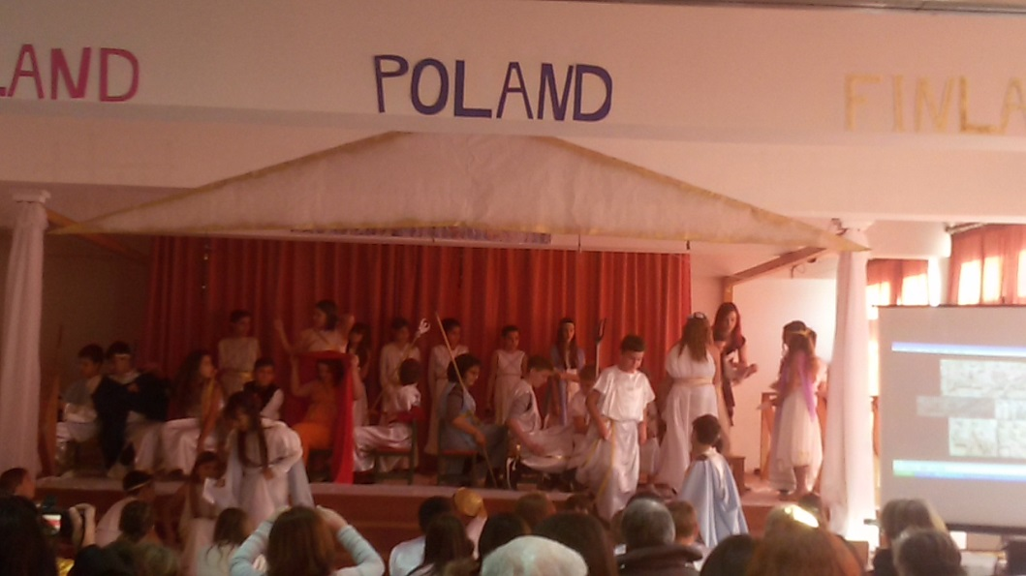
Module 4- Drama: Revealing the secrets of the Parthenon

Slide 10
Module 5: Ancient Olympic sports

