Slide 1
Transnational Learning meeting in Catalonia (March 2017) by Christine Aggelopoulou (5th grader)

Slide 2
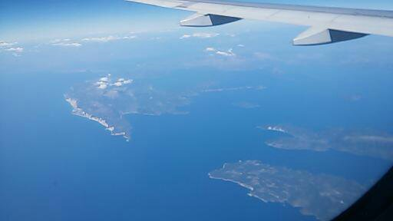
The flight took 3 hours and the experience was amazing.

Slide 3
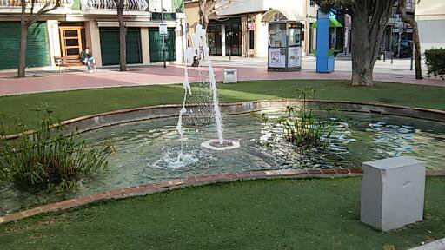
We arrived at 11.00 o’clock on Sunday morning. The host families welcomed us all!

Slide 4
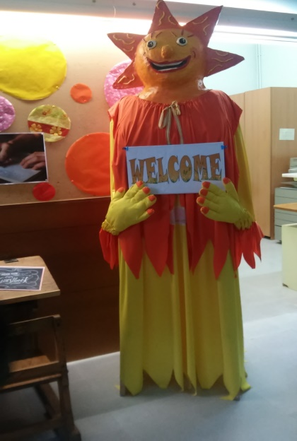
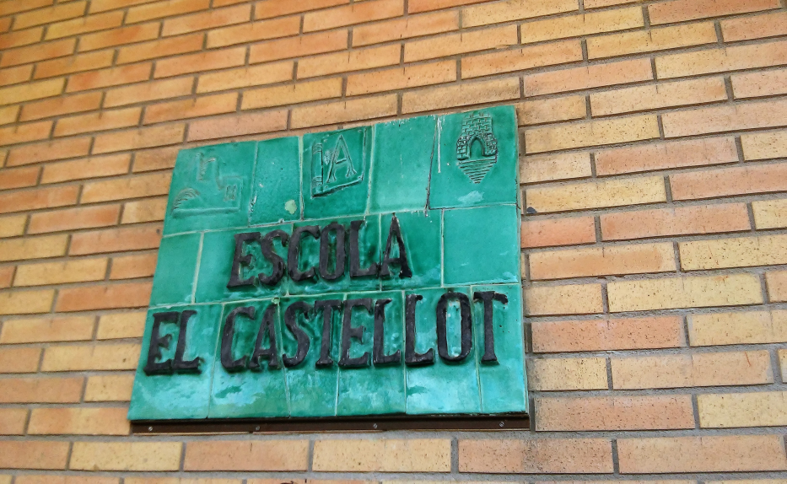
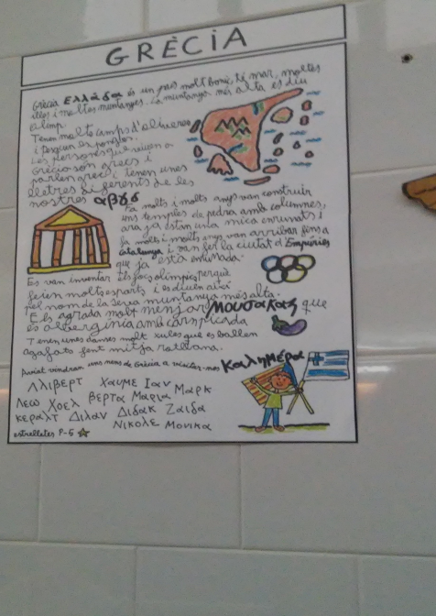
First day at school
On Monday we went to school. There the children from Catalonia sang some songs for us and they gave us gifs. Later they taught us Catalan dances. The “stick dance” was really fun!

Slide 6
Discovering the city
After the ceremony we played the treasure hunt! They divided us into groups, gave us a map with some places that we should go to, and took part in some challenging tasks in order to get some clothes (actually those clothes were pieces of the traditional costume of a local man).

Slide 7
Back to families
After the end of the school we went back to the families. We followed their programme, which was specially organized just for us! Each family did different things.

Slide 8
Antonio Gaudi
On Tuesday we presented our traditional dances to the 3rd and 4th grades. Later on, after the break, the Catalan children talked to us about the famous architect of Catalonia, Antonio Gaudi. They talked about his architectural style and the way he designed the buildings. We also made the lizard of his park with paper and other different materials.

Slide 9
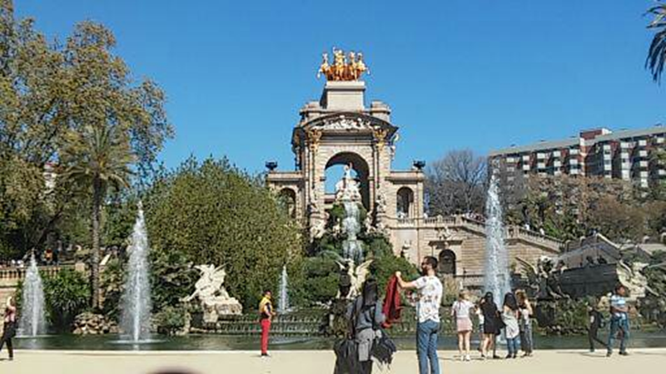
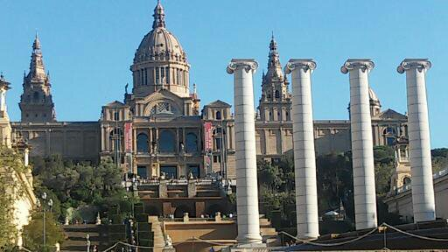
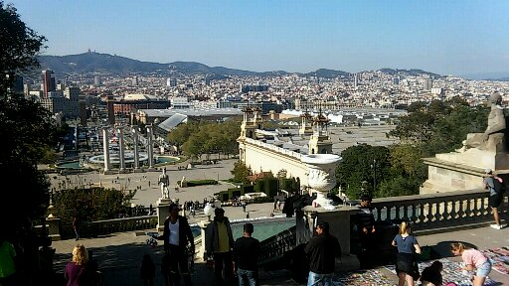
On Wednesday we went to Barcelona and visited some amazing landmarks .

Slide 10
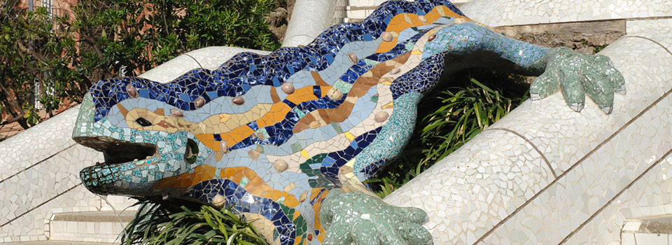

Slide 11
Sagrada familia
Sagrada familia is a church that was built by the famous architect Antonio Gaudi. Antonio loved nature and this love was expressed in his designs. Various beautiful shapes of animals, serpents, trees, flowers are everywhere in Sagrada familia.

Slide 12
Sagrada familia
Sagrada familia is the tallest church in Spain, but not taller than the highest mountain in Spain, because Gaudi did not want it to be bigger than the God’s work.
So you can understand that Gaudi also loved God a lot .

Slide 13
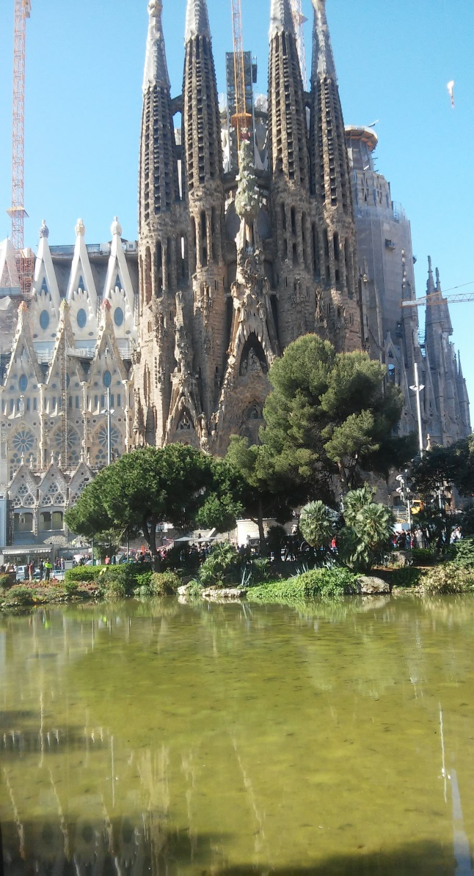
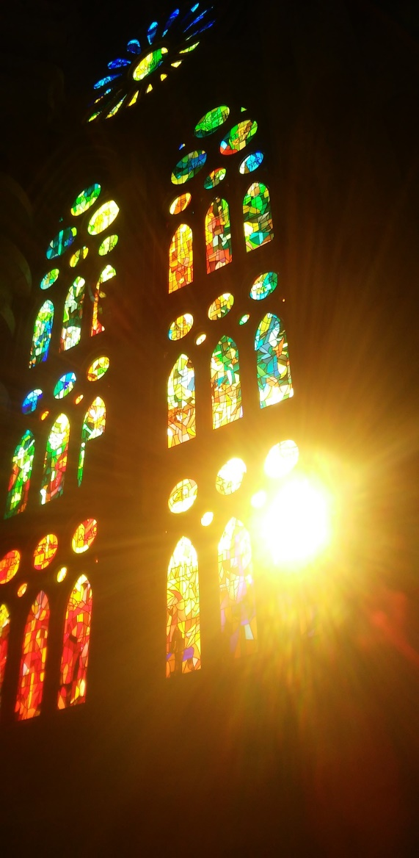
Sagrada familia

Slide 14
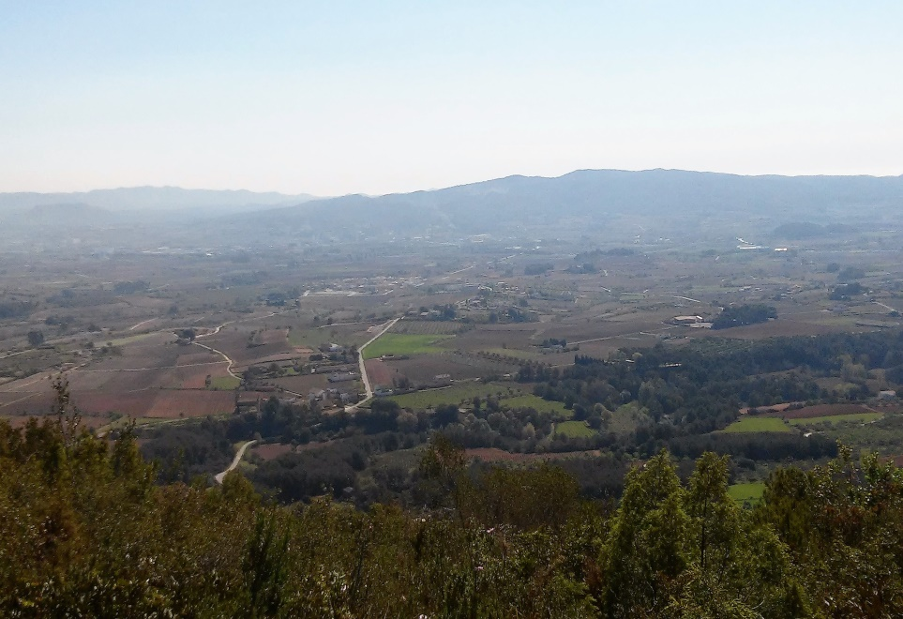
Hiking
On Thursday we went hiking. From the top of the mountain the view was breathtaking!

Slide 15
Closing ceremony
Later in the evening we danced ‘ZORBAS DANCE’ at the parents’ meeting. Each country had to make a presentation. After that we attended the closing ceremony and tasted traditional Catalan food.

Slide 16
Vilafranca
On Friday we went to Vilafranca area and did lots of activities. One of them was the Human Towers.
We also visited a cathedral with tall towers and a wonderful view.

Slide 17
THE VIEW FROM THE CHURCH

Slide 18
Exciting activities
Later we did zip-line and other climbing activities. It was really thrilling!!!
The next day we came back to Greece. We were happy to see our parents, but we were also sad to leave the Catalan families.
I had a great experience and I will never forget this trip because I made a lot of friends and I learnt the culture of this beautiful area, CATALONIA!!!

